Slide 1
Chapter 06
The Bond Market
(Why Bond markets is an important source for fund raising for government and public limiter corporation, who invest in it and why.

Slide 2
The Bond Market
Investors use the money markets primarily to warehouse funds for short periods of time
On the other side, capital markets are used for long-term investments
The primary reason that individuals and firms choose to borrow long-term is to reduce the risk that interest rates will rise before they pay off their debt
Most long-term interest rates are higher than short-term rates due to risk premiums

Slide 3
Capital Market Participants
The federal government issues long-term notes and bonds to fund the national debt
State and municipal governments also issue long-term notes and bonds to finance capital projects, such as school and prison construction
Governments never issue stock because they cannot sell ownership claim
Corporations issue both bonds and stock
The distribution of a firm’s capital between debt and equity is its capital structure

Slide 4
Capital Market Trading
Capital market trading occurs in either the primary market or the secondary market
The capital markets have well-developed secondary markets
Unlike most money market transactions, capital market transactions, measured by volume, occur in organized exchanges
Exchange rules govern trading to ensure the efficient and legal operation of the exchange

Slide 5
Types of Bonds
Long-term government notes and bonds
  Treasury Notes and Bonds
    Agency Bonds
Municipal bonds
  General obligation bonds
  Revenue bonds
Corporate bonds
  Bearer bonds
  Registered bonds
  Secured Bonds
  Unsecured Bonds
  Junk Bonds

Slide 6
Treasury Notes and Bonds
Treasury notes have an original maturity of 1 to 10 years
Treasury bonds have an original maturity of 10 to 30 years
Whereas Treasury bills mature in less than one year
Federal government notes and bonds are free of default risk because the government can always print money to pay off the debt if necessary
Treasury bonds have very low interest rates because they have no default risk. Investors in Treasury bonds have found themselves earning less.

Slide 7
Treasury Notes and Bonds
Treasury Inflation-Protected Securities (TIPS)
The inflation-indexed bonds have fixed interest rate
However, the principal amount used to compute the interest payment changes based on the consumer price index.
At maturity, the securities are redeemed at the greater of their inflation-adjusted principal or par amount at original issue.
Also referred to as inflation-protected securities

Slide 8
Treasury Notes and Bonds
Treasury STRIPS
  Separate Trading of Registered Interest and Principal Securities
The periodic interest payments are separated from the final principal repayment
Each interest payment and the principal payment becomes a separate zero-coupon security and can be held or traded separately
E.g Treasury note with 5 years remaining to maturity & 10 interest payments (semi-annual)
When this note is stripped, single Treasury note becomes 11 separate securities that can be traded individually

Slide 9
Treasury Notes and Bonds
Agency Bonds
Agencies are government-sponsored enterprises (GSEs).
Issuers of agency bonds include:
  Student Loan Marketing Association (Sallie Mae)
  Federal National Mortgage Association (Fannie Mae)
  Federal Home Loan Mortgage Corporation (Freddie Mac)
  Farmers Home Administration
  Federal Housing Administration
  Veterans Administrations
  Federal Land Banks
These agencies issue bonds to raise funds that are used for purposes that Congress has deemed to be in the national interest

Slide 10
Municipal Bonds
Securities issued by local, county, and state governments
Municipal bonds that are issued to pay for essential public projects are exempt from federal taxation
General obligation bonds
  Backed by the “full faith and credit” of the issuer.
  Issuer promises to use every resource available to repay the bond as promised
Revenue bonds
  Backed by the cash flow of a particular revenue-generating project.
  For example, revenue bonds may be issued to build a toll bridge, with the tolls being pledged as repayment

Slide 11
Municipal Bonds
Municipal bonds are not default-free
Default rates are higher during periods when the economy is weak
Unlike the federal government, local governments cannot print money
There are real limits on how high they can raise taxes without driving the population away

Slide 12
Corporate Bonds
Most corporate bonds have a face value of $1,000 and pay interest semiannually (twice per year).
Most are also callable, meaning that the issuer may redeem the bonds after a specified date
The bond indenture is a contract that states the lender’s rights and privileges and the borrower’s obligations
The degree of risk varies widely among different bond issues because of the financial health of the issuer
The interest rate on corporate bonds varies with the level of risk

Slide 13
Corporate Bonds
Secured bonds are ones with collateral attached. Mortgage bonds are used to finance a specific project. For example, a building may be the collateral for bonds issued for its construction
As a result, they will have a lower interest rate
Equipment trust certificates are bonds secured by tangible non-real-estate property, such as heavy equipment or airplanes.
Presence of collateral reduces the risk of the bonds and so lowers their interest rates.

Slide 14
Corporate Bonds
Unsecured Bonds
Debentures are long-term unsecured bonds that are backed only by the general creditworthiness of the issuer.
No specific collateral is pledged to repay the debt. In the event of default, the bondholders must go to court to seize assets
Debentures have lower priority than secured bonds if the firm defaults.
As a result, they will have a higher interest rate than secured bonds

Slide 15
Corporate Bonds
Subordinated debentures
Similar to debentures except that they have a lower priority claim
If default occurs, subordinated debenture holders are paid only after non subordinated bondholders have been paid in full
Variable-rate bonds
The interest rate on these securities is tied to another market interest rate, such as the rate on Treasury bonds, and is adjusted periodically

Slide 16
Corporate Bonds
Junk Bonds
All bonds are rated by various companies according to their default risk
A bond with a rating of AAA has the highest grade possible
Bonds at or above Moody’s Baa or Standard and Poor’s BBB rating are considered to be of investment grade.
Those rated below this level are usually considered speculative
Speculative-grade bonds are often called junk bonds
Study case of Michael Milken

Slide 17
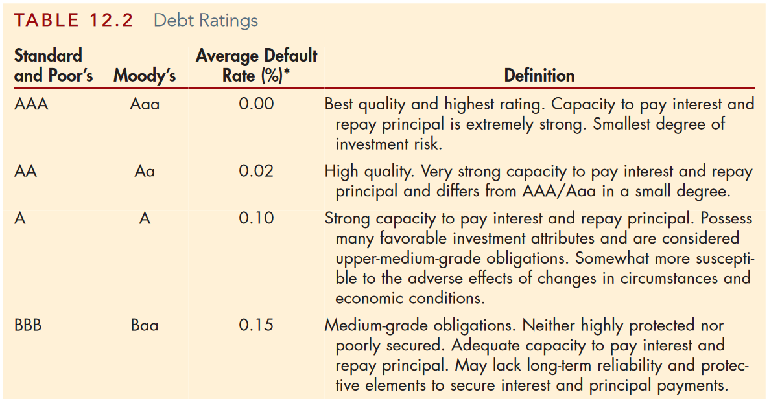

Slide 18
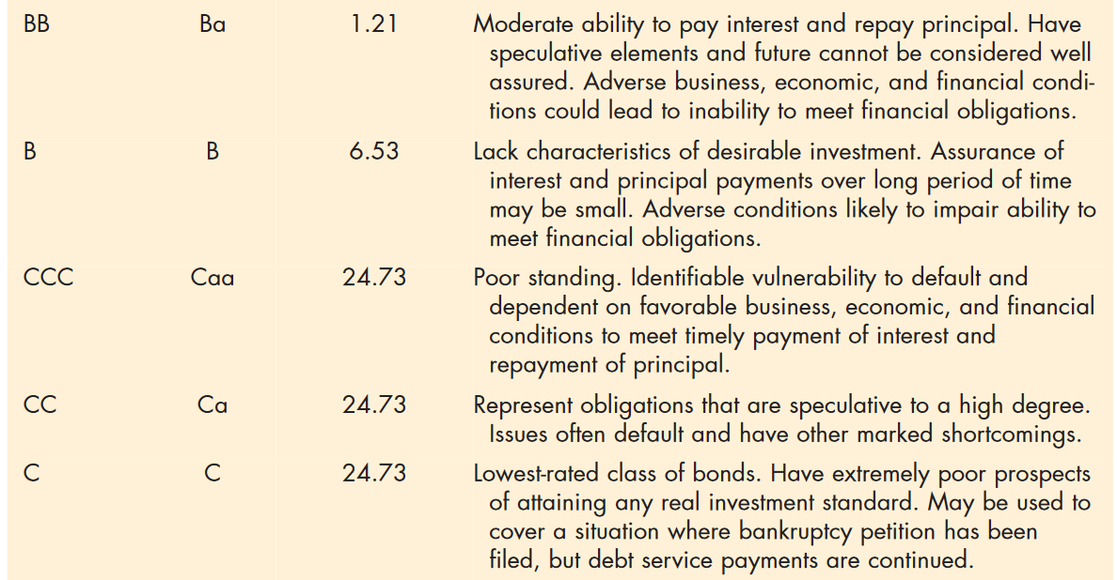

Slide 19
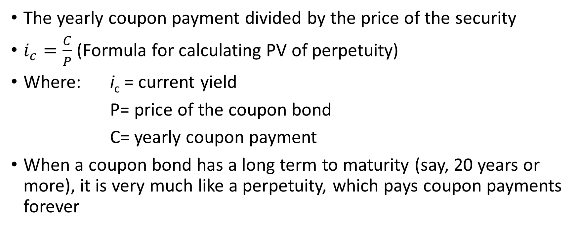
Current Yield Calculation
The yearly coupon payment divided by the price of the security
$i_{c}=\frac{C}{P}$ (Formula for calculating PV of perpetuity)
Where: i_{c} = current yield
P= price of the coupon bond
C= yearly coupon payment
When a coupon bond has a long term to maturity (say, 20 years or more), it is very much like a perpetuity, which pays coupon payments forever

Slide 20
